Slide 1

7th Grade Math
Unit 6, Lesson 4 Converting Mass and Area Volume 1, pg. 251

Slide 2


Benchmark
MA.7.AR.3.3
Solve mathematical and real-world problems involving the conversion of units across different measurement systems.
volume 1, pg. 251

Slide 3
Integrated Mathematical Thinking and Reasoning Standards
MA.K12.MTR.3.1 Complete tasks with mathematical fluency.
MA.K12.MTR.4.1 Engage in discussions that reflect on the mathematical thinking of self and others.
volume 1, pg. 251

Slide 4

Learning Target
I can solve problems involving conversion of mass and area measurements across different measurement systems.
volume 1, pg. 251

Slide 5

Warm-Up
volume 1, pg. 252

Slide 6
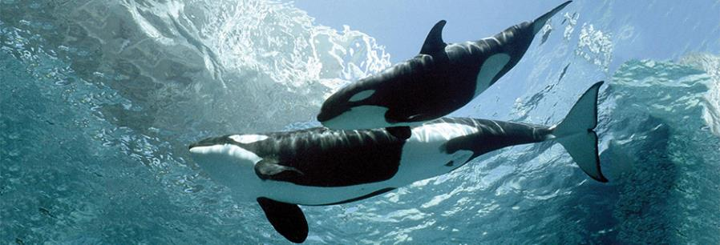
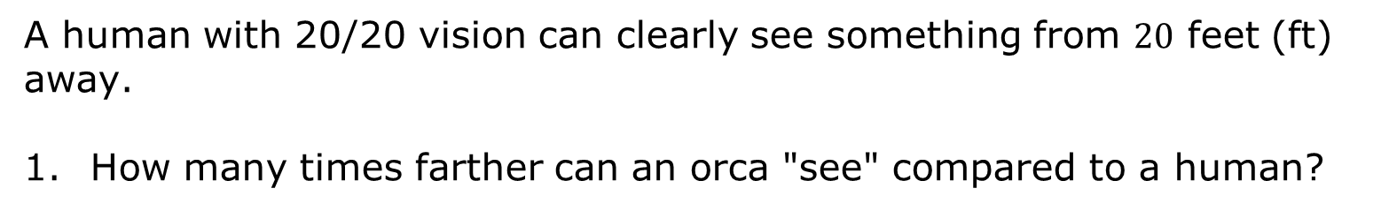
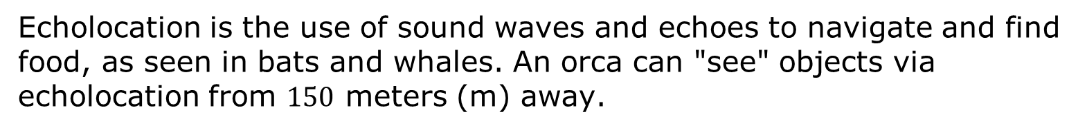
6.4.1 Warm-Up: Orca vs. Human
Echolocation is the use of sound waves and echoes to navigate and find food, as seen in bats and whales. An orca can "see" objects via echolocation from $150$ meters (m) away.
A human with 20/20 vision can clearly see something from $20$ feet (ft) away.
How many times farther can an orca "see" compared to a human?
volume 1, pg. 252

Slide 7

Guided Instruction
volume 1, pg. 252

Slide 8


6.4.2 Guided Instruction: Conversions of Mass and Weight
In the metric system of measurement, the most common units for measuring mass include milligrams (mg), grams (g), and kilograms (kg). In the customary system, the most common units for measurement for weight include ounces (oz), pounds (lb), and tons (t).
Weight vs. Mass
Weight and mass are often used interchangeably, but they are not quite the same, as you’ll learn in science. The mass of an object never changes, but its weight changes depending on gravity. For example, your weight on Earth and your weight on the moon would be different, while your mass would remain the same. Since you’re in math class here on Earth, mass and weight will be used interchangeably.
volume 1, pg. 252

Slide 9
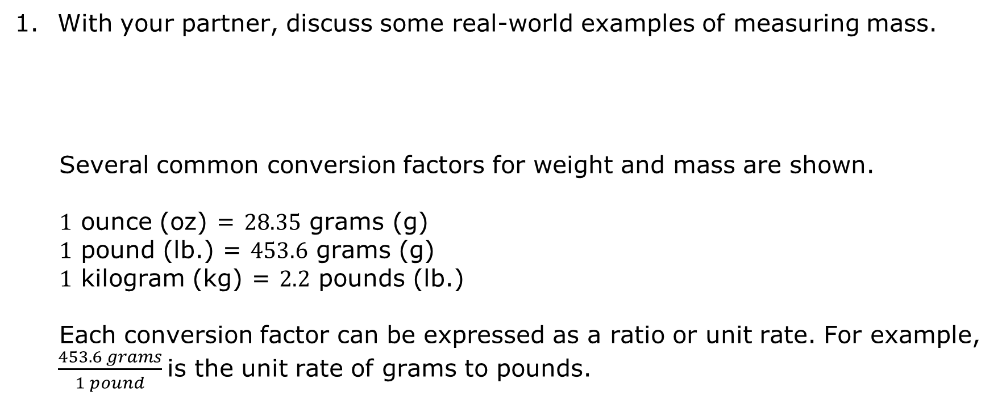
With your partner, discuss some real-world examples of measuring mass.
Several common conversion factors for weight and mass are shown.
$1$ ounce (oz) = $28.35$ grams (g)
$1$ pound (lb.) = $453.6$ grams (g)
$1$ kilogram (kg) = $2.2$ pounds (lb.)
Each conversion factor can be expressed as a ratio or unit rate. For example, $\frac{453.6 grams}{1 pound}$is the unit rate of grams to pounds.
volume 1, pg. 252

Slide 10
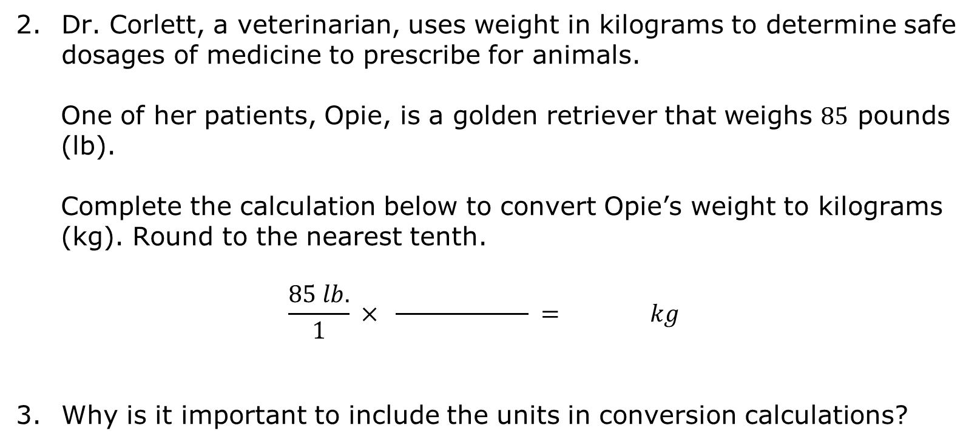
Dr. Corlett, a veterinarian, uses weight in kilograms to determine safe dosages of medicine to prescribe for animals.
One of her patients, Opie, is a golden retriever that weighs $85$ pounds (lb).
Complete the calculation below to convert Opie’s weight to kilograms (kg). Round to the nearest tenth.
$$\frac{85 lb.}{1} × \frac{ }{ } = kg$$
Why is it important to include the units in conversion calculations?
volume 1, pg. 253

Slide 11
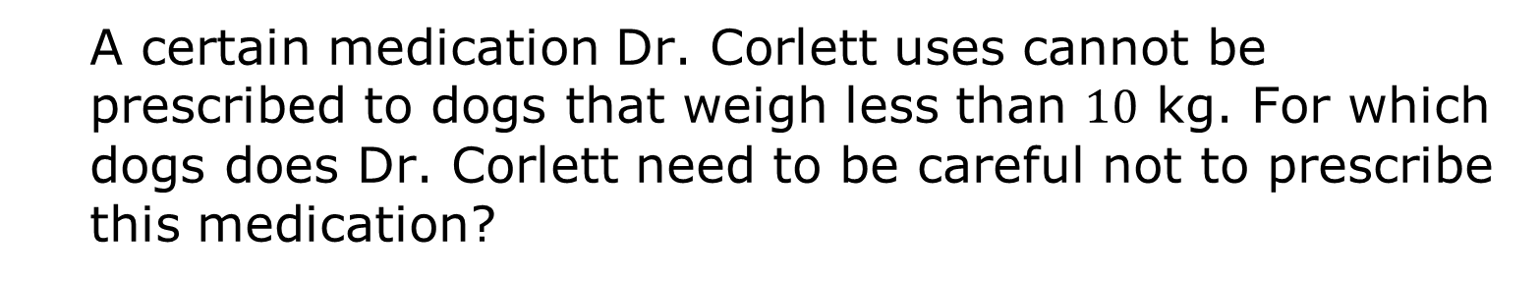
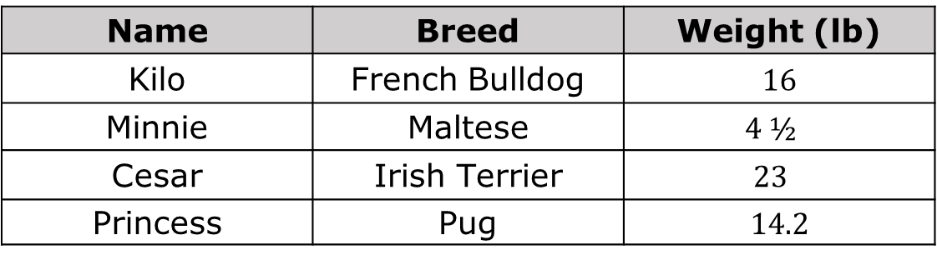
The table includes information about several of Dr. Corlett’s patients.
Name | Breed | Weight (lb)
Kilo | French Bulldog | $16$
Minnie | Maltese | $$4 ½$$
Cesar | Irish Terrier | $$23$$
Princess | Pug | $14.2$
A certain medication Dr. Corlett uses cannot be prescribed to dogs that weigh less than $10$ kg. For which dogs does Dr. Corlett need to be careful not to prescribe this medication?
volume 1, pg. 253

Slide 12

Collaboration
volume 1, pg. 253

Slide 13

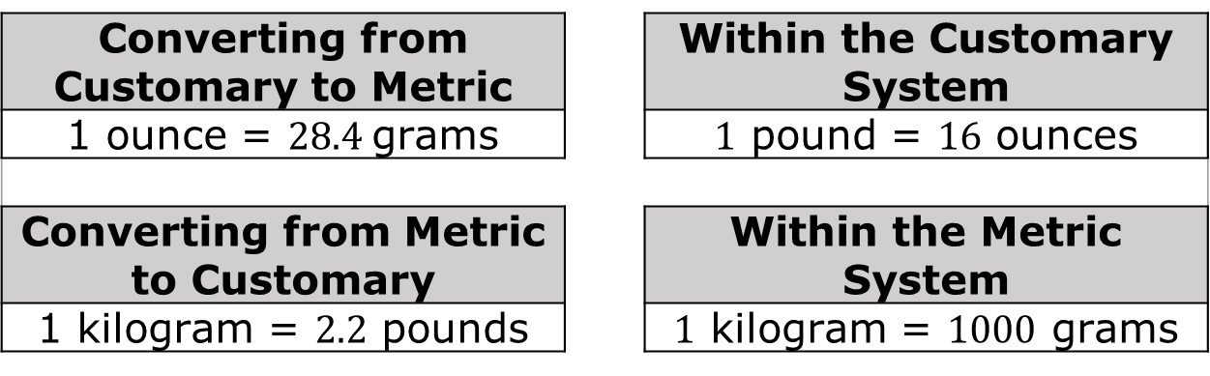
6.4.3 Collaboration: Conversions Within and Between Systems
Conversion factors that can be used to convert mass between and within measurement systems are shown.
Converting from Customary to Metric |  | Within the Customary System
1 ounce = $28.4$grams |  | $1$ pound = $16$ ounces
Converting from Metric to Customary |  | Within the Metric System
1 kilogram = $2.2$ pounds |  | $1$ kilogram = $1000$ grams
volume 1, pg. 253

Slide 14
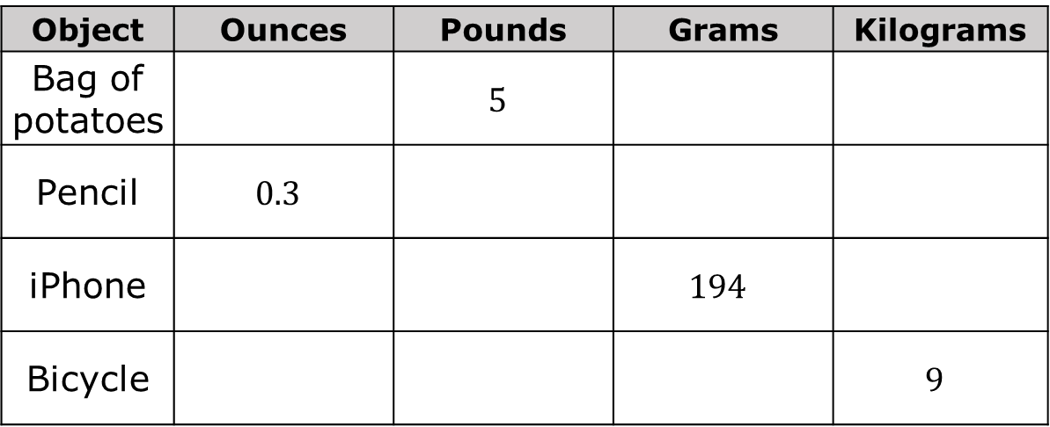
The weights and masses of four objects are given in the table. Work with your partner to complete the table by using the conversion factors listed. Round to the nearest thousandth when necessary.
Object | Ounces | Pounds | Grams | Kilograms
Bag of potatoes |  | $$5$$
Pencil | $$0.3$$
iPhone |  |  | $$194$$
Bicycle |  |  |  | $$9$$
volume 1, pg. 253

Slide 15
Guided Instruction
volume 1, pg. 254

Slide 16

6.4.4 Guided Instruction: Conversions of Areas
What does area measure?
What type of units are used to measure area?
volume 1, pg. 254

Slide 17


Luciana is a wildlife biologist who studies the habitat of the Florida Panther. Florida Panthers are tracked using radio collars to determine the area in which the panther lives. The rectangular habitat of one of the panthers is shown, where the dimensions are given in kilometers (km).
Two students used different methods and conversion factors to find the area of the panther’s habitat in square miles (mi²).
$$10 km$$
$$11 km$$
volume 1, pg. 254

Slide 18
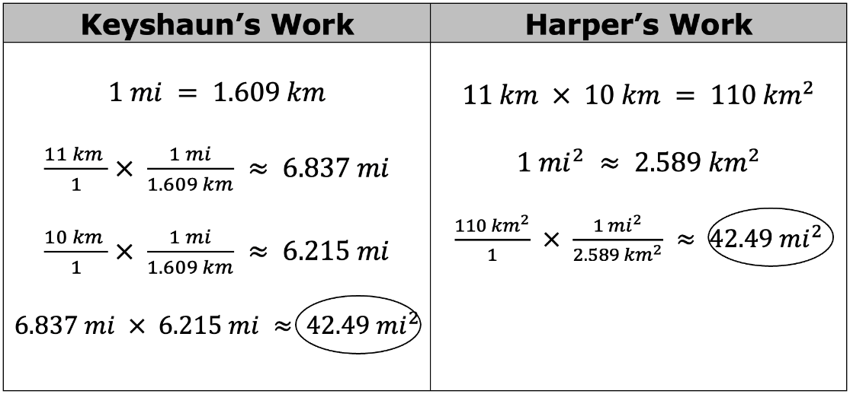
Draw an asterisk (*) next to the conversion factor that each student used.
volume 1, pg. 254

Slide 19
Discuss each student’s work with your partner. Then, write a brief description of how each person found the area of the panther’s habitat in square miles.
Keyshaun’s Work | Harper’s Work
volume 1, pg. 254

Slide 20

Keyshaun and Harper used different conversion factors, but still found the same answer. How are their conversion factors related?
Why did Keyshaun and Harper use the symbol ≈ in their calculations?
volume 1, pg. 254

Slide 21

Try It
volume 1, pg. 255

Slide 22

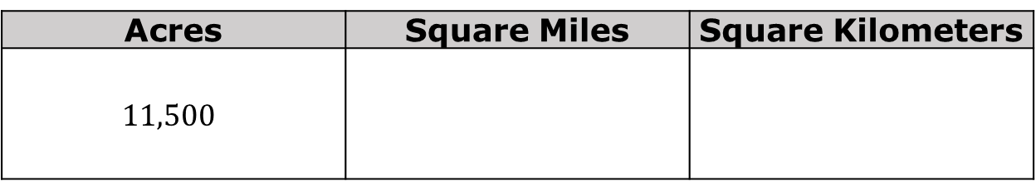
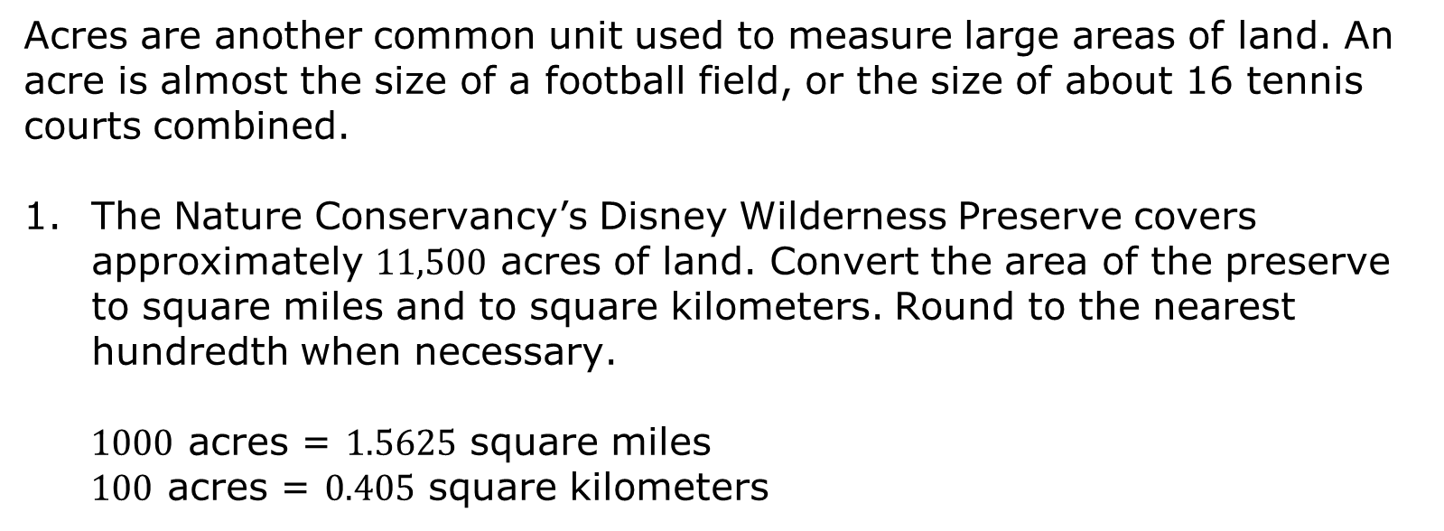
6.4.5 Try It: Conversions of Area
Acres are another common unit used to measure large areas of land. An acre is almost the size of a football field, or the size of about 16 tennis courts combined.
The Nature Conservancy’s Disney Wilderness Preserve covers approximately $11,500$ acres of land. Convert the area of the preserve to square miles and to square kilometers. Round to the nearest hundredth when necessary.
$1000$ acres = $1.5625$ square miles
$100$ acres = $0.405$ square kilometers
Acres | Square Miles | Square Kilometers
$$11,500$$
volume 1, pg. 255

Slide 23

Your Turn
volume 1, pg. 255

Slide 24

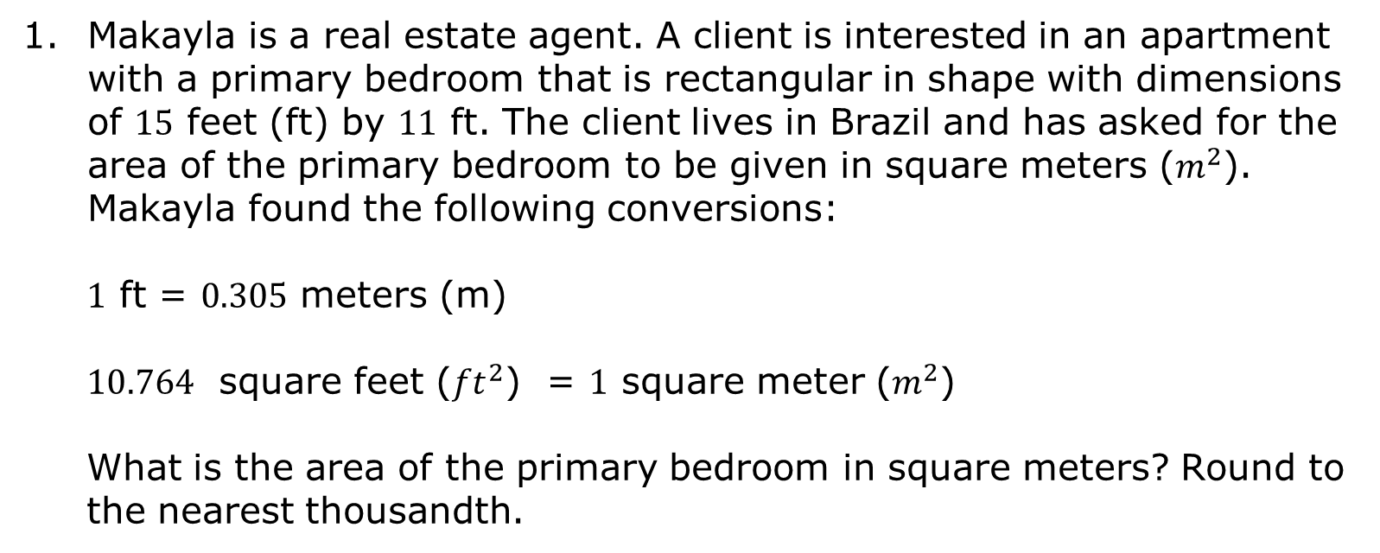
6.4.6 Your Turn!
Makayla is a real estate agent. A client is interested in an apartment with a primary bedroom that is rectangular in shape with dimensions of $15$ feet (ft) by $11$ ft. The client lives in Brazil and has asked for the area of the primary bedroom to be given in square meters ($m^{2}$). Makayla found the following conversions:
$1$ ft = $0.305$ meters (m)
$10.764$ square feet (${ft}^{2}$) = $1$ square meter ($m^{2}$)
What is the area of the primary bedroom in square meters? Round to the nearest thousandth.
volume 1, pg. 255

Slide 25
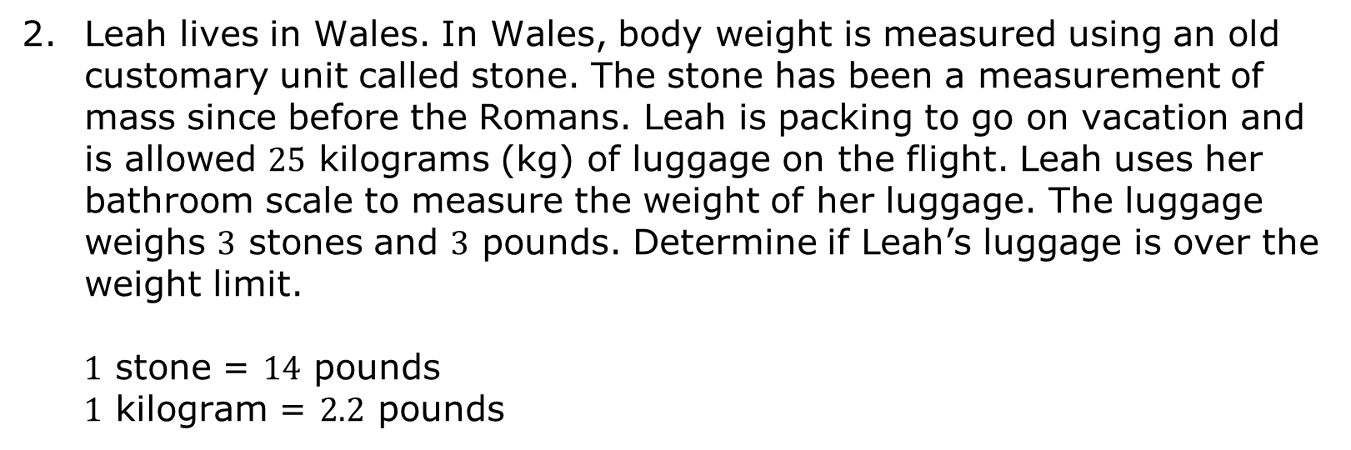
Leah lives in Wales. In Wales, body weight is measured using an old customary unit called stone. The stone has been a measurement of mass since before the Romans. Leah is packing to go on vacation and is allowed $25$ kilograms (kg) of luggage on the flight. Leah uses her bathroom scale to measure the weight of her luggage. The luggage weighs $3$ stones and $3$ pounds. Determine if Leah’s luggage is over the weight limit.
$1$ stone = $14$ pounds
$1$ kilogram = $2.2$ pounds
volume 1, pg. 255

Slide 26

Wrap-Up
volume 1, pg. 256

Slide 27
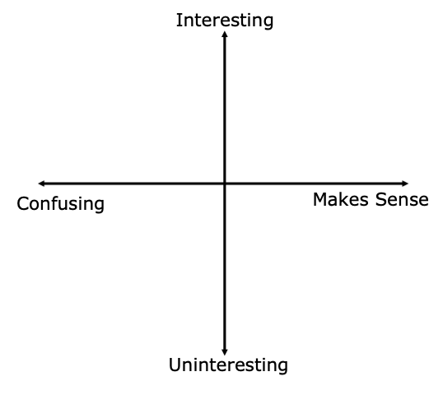
6.4.7 Wrap-Up: Reflection
Plot a point on the grid below to indicate how interesting you find the lesson, along with how much sense the lesson made to you, for today’s learning target.
I can solve problems involving conversion of mass and area measurements across different measurement systems.
volume 1, pg. 256

